Slide 1
The Zen of Coding
Day 1
August 2, 2016

Slide 2

Quick Introductions! (30 seconds)
Name
Where From?
Background (Career, Education, Interests)
Why learn web development?
Fears about class?

Slide 3
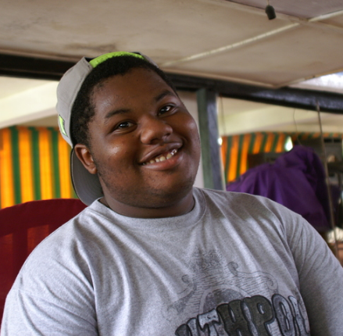
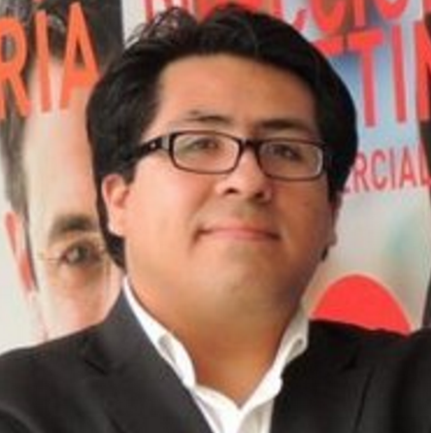
Our All-Star TAs
Nate “The DJ” Hawley
Will “Da Man” Vasquez

Slide 4

Instructor = … ?
Ahmed Haque
Curriculum Director for Rutgers Coding Bootcamp (i.e. I make the misery)
PhD Candidate in Bioengineering from Rice U.
Over 8 years coding, (with plenty of experience being a n00b at it.)
LOVES teaching
Also a Self-Help Junkie…

Slide 5
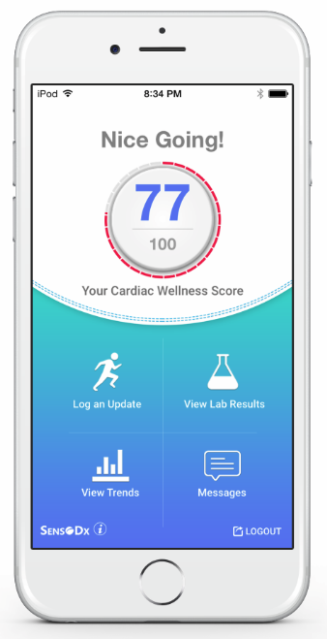
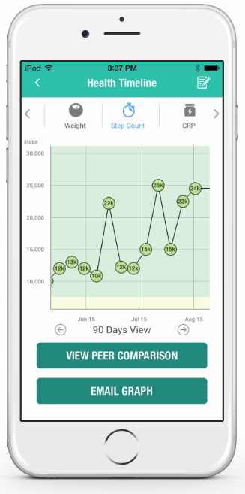
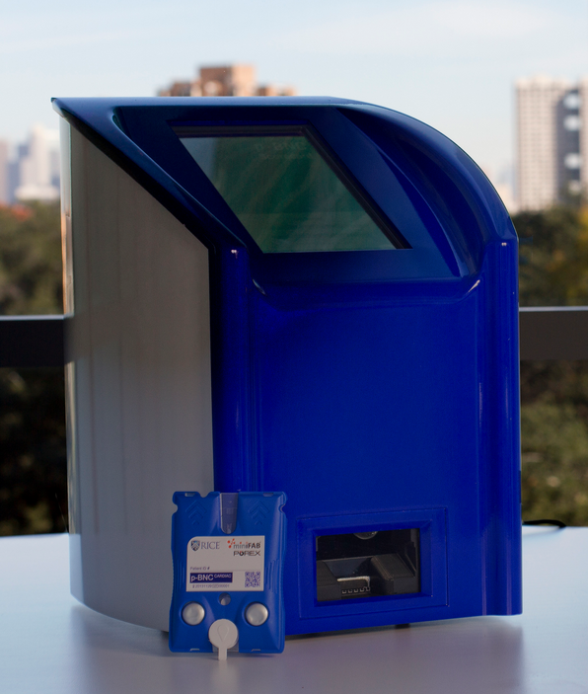
Things I’ve Worked On…
Biomarkers
Coding
Awesome Health (Yay!)

Slide 6

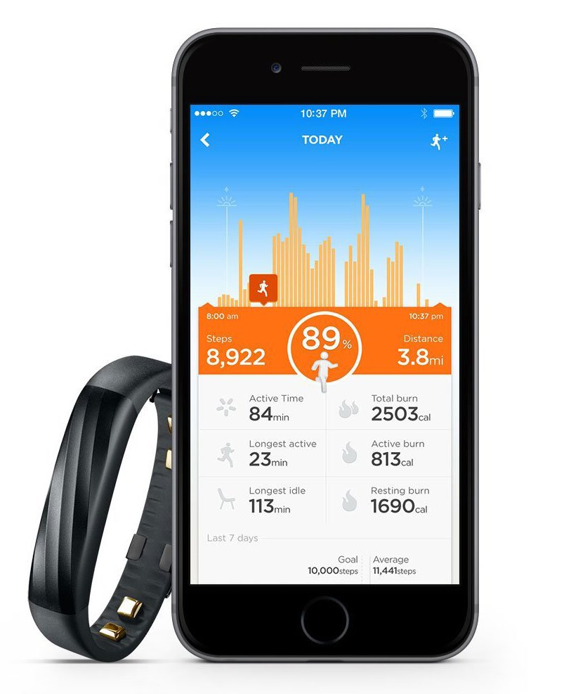
Things I’ve Worked On…
Jawbone UP3 a wearable device for tracking heart rate, step count,and more. (lol. It totally bombed in the market)

Slide 7
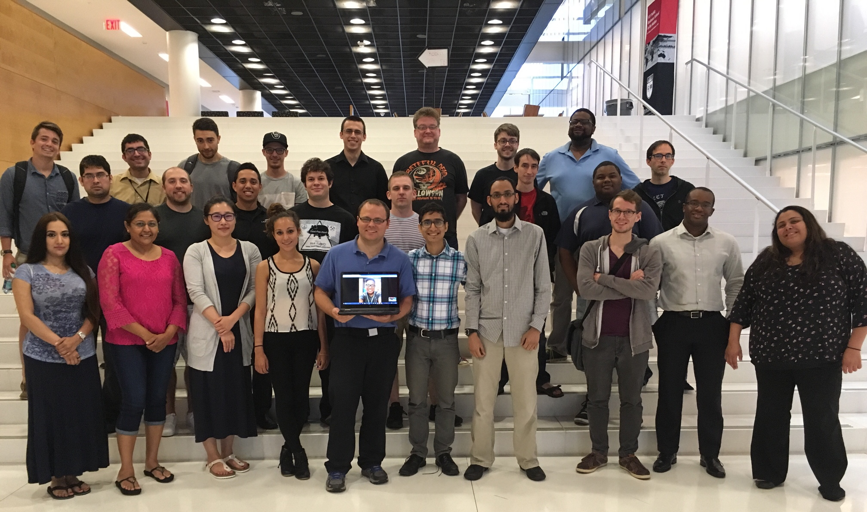
Thing I’m Most Proud Of…
Notes:
To be quite frank. I am excited by the prospect of teaching. And I love the fact that this crowd is all students who are coming back to school.
I’ve seen people succeed in this program from all professional backgrounds and all levels of experience in web development. From someone who could barely type to someone who had spent a lot of time in technology project management.
Everyone can come here. And everyone can gain.

Slide 8
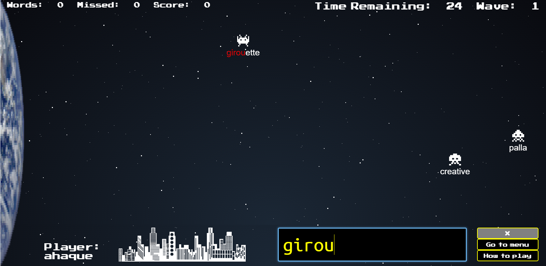


Thing I’m Most Proud Of…
WordWars
http://wordwarsapp.herokuapp.com/game
Musicality
https://musicalityapp.herokuapp.com/
WithnReach
http://45.63.12.88/withinreach/

Slide 9
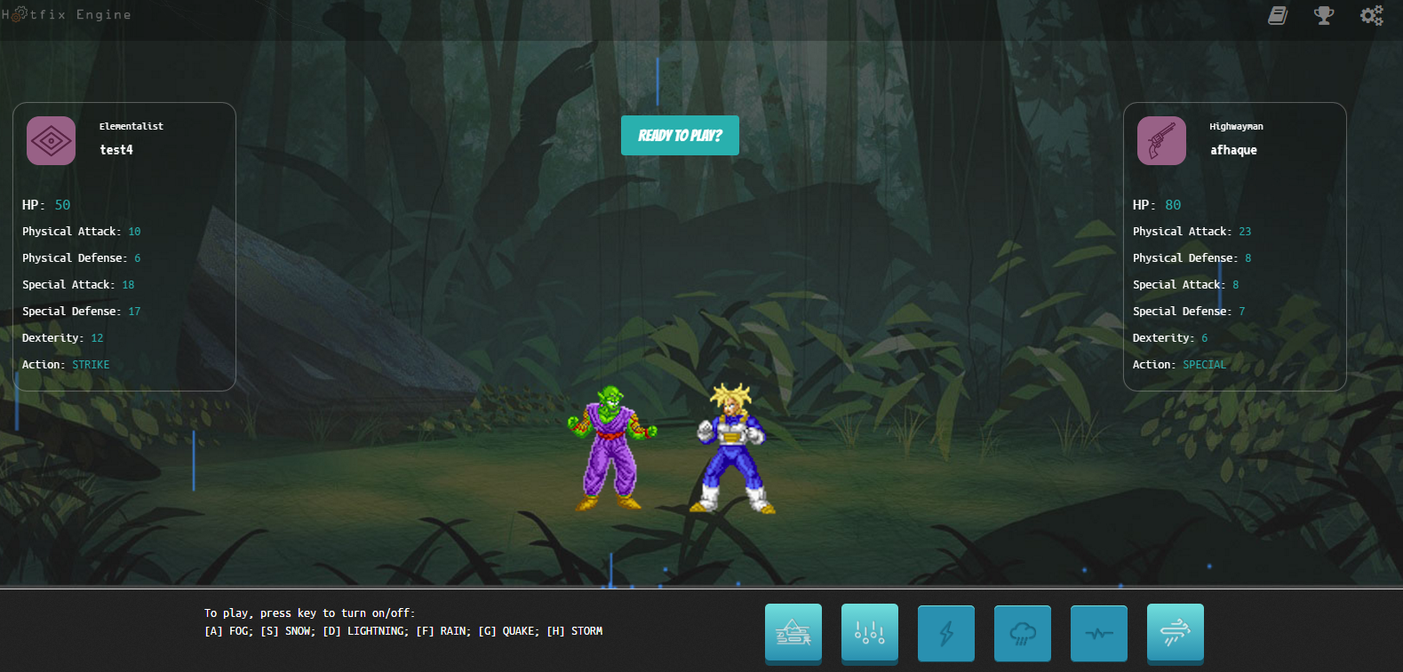
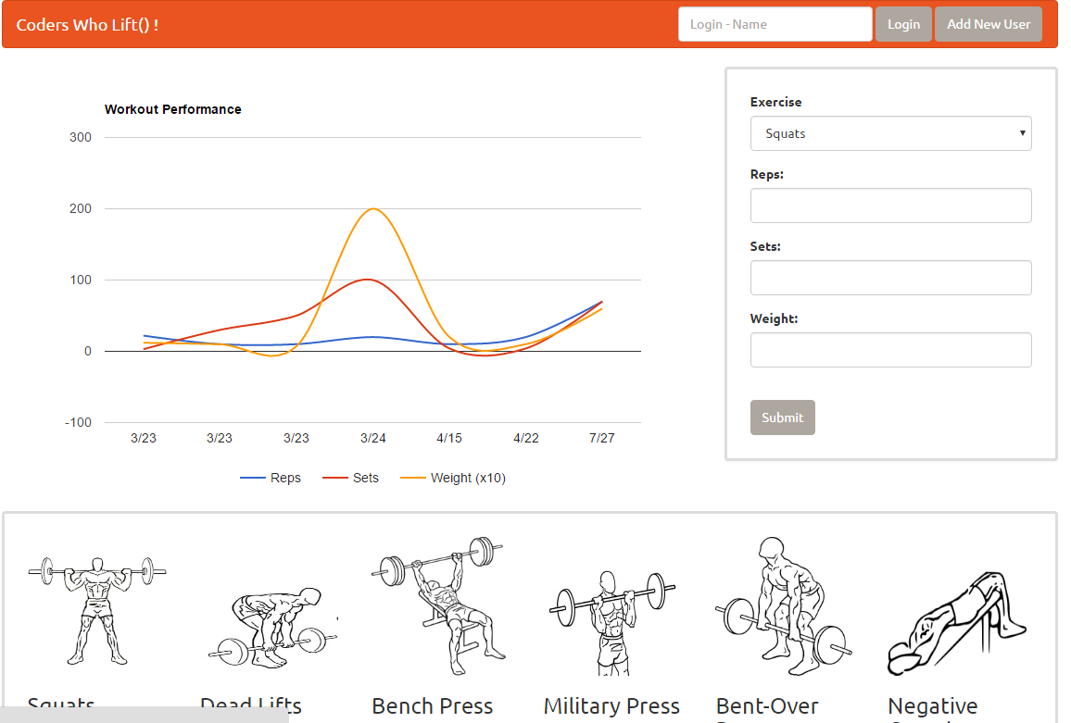
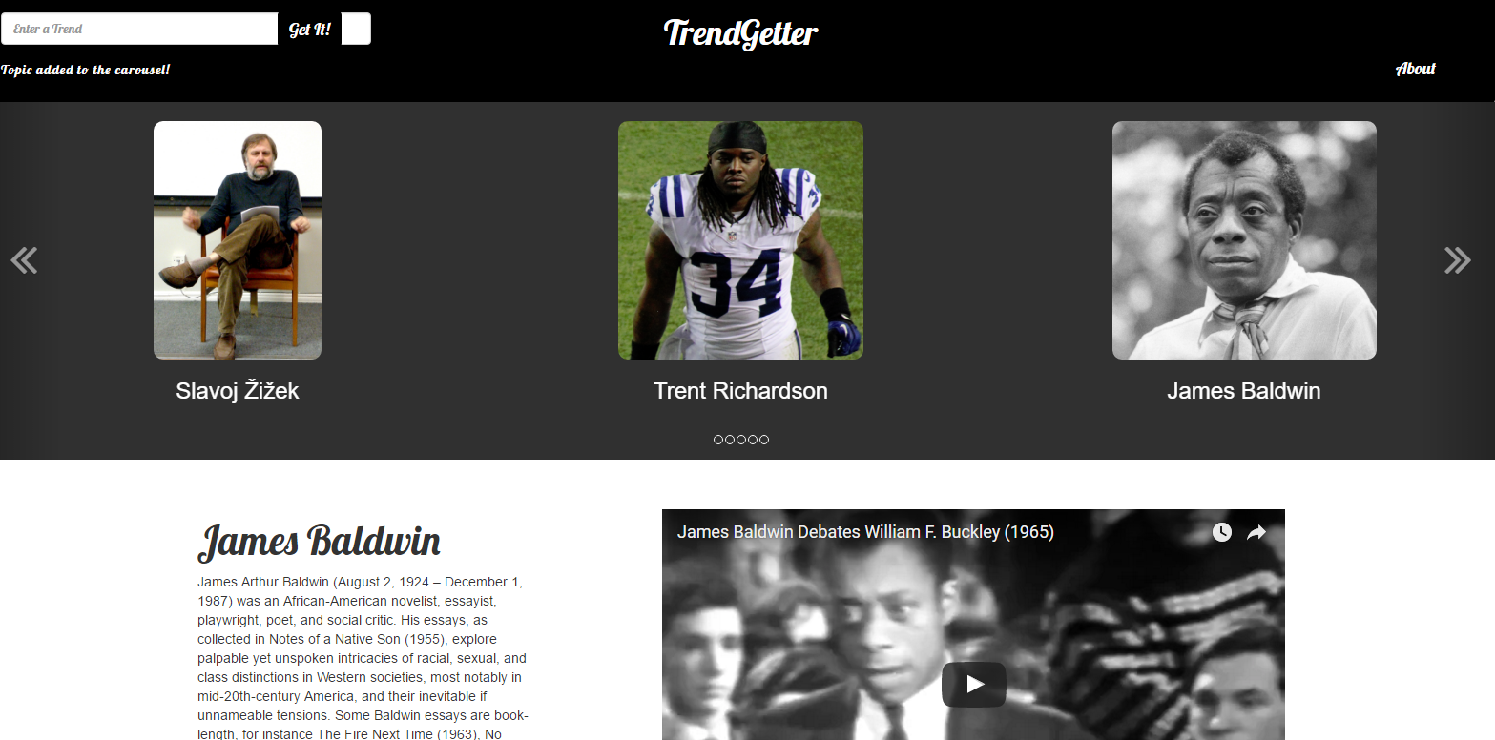
Thing I’m Most Proud Of…
Hotfix Engine
http://hotfixengine.herokuapp.com/game/
Coders Who Lift()
https://coderswholift.herokuapp.com/
TrendGetter
http://trendgetter.herokuapp.com/

Slide 10
On Goals…
Notes:
What I will tell you guys is this. I love doing this.
And why I love doing this is that it’s not about “coding” to me. It’s about opportunities. It’s about helping people reach out to their potential.

Slide 11
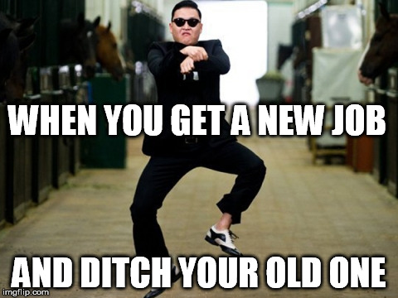
Your Goals...
New Career
Basically 1000% of you said…

Slide 12
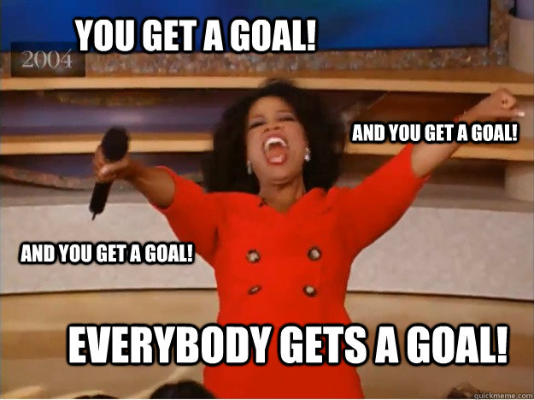
Your Goals...
And why do you want a new career?
To escape a “dead-end job”
To pursue a “dream”
To be able to “create”
To follow a “fascination”
To attain “financial stability”
To attain “financial freedom”
To “challenge” yourself
To be a “role model” for kids

Slide 13
Your Goal = Our Goal
As an instructor,
I take your goal extremely seriously.

Slide 14
Support Team
Our Promise:
If you’re willing to put in the time – and you take our advice, we’re here to help you 100% of the way.
This goes for everyone working behind the program:
Instructors
TAs
Student Success Team
Career Coaches
Everyone Else!

Slide 15
But Remember…
Nothing good comes easy.

Slide 16
On Keys To Success…

Slide 17
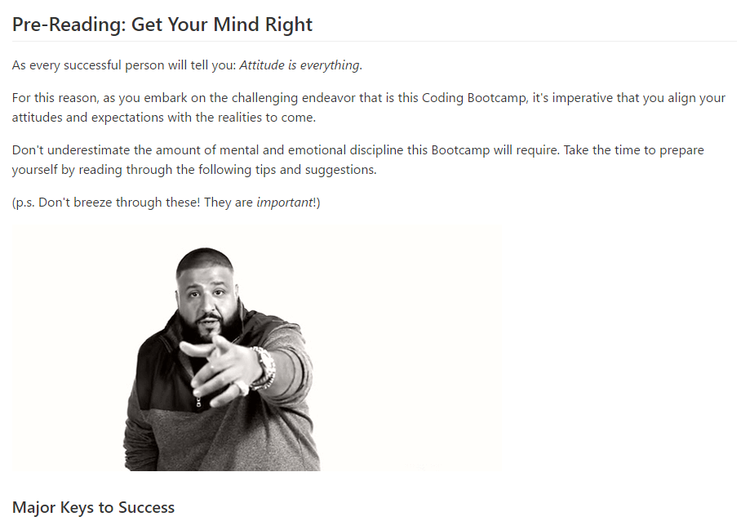
Attitude is Everything!
Make Sure to Read This:
https://github.com/afhaque/KeysToSucceed
Notes:
Read this. Internalize it. Memorize it. Do not forgot those keys.

Slide 18

Don’t Be This Guy…
Notes:
Those that have the hardest time in the program are not the ones who came in knowing no programming.
It’s not the ones who haven’t played around with HTML, CSS, or Javascript.
It’s the ones who walk in thinking they either A) Know more than they do. Or B) Are experts in a completely different field.
There is something that stops people like this from accepting the reality.

Slide 19

This Should Be You.

Slide 20
Our Mantra for Today and Beyond…
When it comes to web development…

Slide 21
Our Mantra for Today and Beyond…
I know nothing.

Slide 22
You.
Notes:
Seriously. Don’t lose sight of this image. At first it may feel intimidating. Knowing how little you know. But relish the opportunity and take the privileges it comes with.
You have permission to struggle. To fail. To not “get” everything immediately.

Slide 23
The Path of Learning

Slide 24
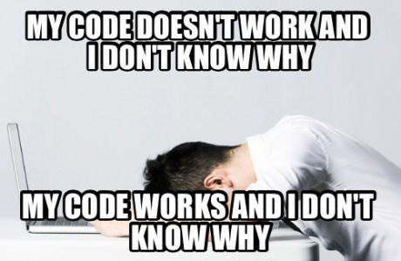
Obstacle #1 – The Great Confusion

Slide 25
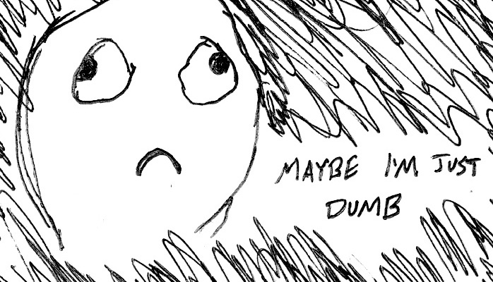
Obstacle #2 – The Great Doubt

Slide 26

Obstacle #3 – The Great Distance

Slide 27
Nothing Comes Easy…
Learning Coding Requires Two Things:
Persisting in the face of something that feels incredibly hard and confusing.
Maintaining the self-confidence necessary to believe that you CAN DO THIS.

Slide 28
Learning is “Frustrating”
“You can’t tell whether you’re learning something when you’re learning it—in fact, learning feels a lot more like frustration.”
“What I’ve learned is that during this period of frustration is actually when people improve the most, and their improvements are usually obvious to an outsider. If you feel frustrated while trying to understand new concepts, try to remember that it might not feel like it, but you’re probably rapidly expanding your knowledge.”
Jeff Dickey, Author of Write Modern Web Apps with the MEAN Stack: Mongo, Express, AngularJS, and Node.JS

Slide 29
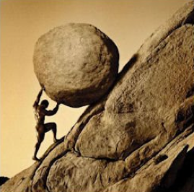
Advice for the Journey
Throughout this course, always remember to:
Work Hard!!

Slide 30
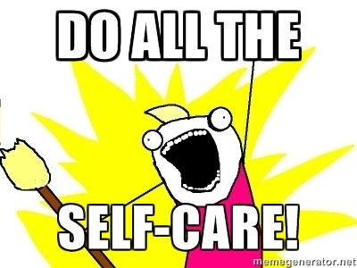
Advice for the Journey
Throughout this course, always remember to:
Work Hard!!
Appreciate your successes

Slide 31

Advice for the Journey
Throughout this course, always remember to:
Work Hard!!
Appreciate your successes
Trust yourself

Slide 32
Course Structure

Slide 33
Daily Schedule
For each class we’ll run through the following:
Set Objectives
Brief Background Lecture
Watch Me / Coding Demos
Code Discussions
In-Class Exercises
Project Work

Slide 34
Daily Schedule
For each class we’ll run through the following:
Set Objectives
Brief Background Lecture
Watch Me / Coding Demos
Code Discussions
In-Class Exercises
Project Work
The Super Important Stuff!!!
i.e. Always be coding!

Slide 35
Today’s Schedule
Students will get to know their classmates, Instructor, TA's, and Support Team.
Students will resolve any issues regarding pre-work and computer setup.
Students will understand the course structure.
Students will learn common Terminal (Mac) / Git Bash (Windows) commands to set up your file and folder structures.
Students will be able to set up a basic HTML document.

Slide 36
Pre-Work

Slide 37
Software Checklist
At this point, you should have each of these installed:
Slack
Sublime Text 3
Git for Version Control
Git Bash (Windows) or Terminal (Mac)
Google Chrome
And we’ll quickly install the below:
Heroku Toolbelt
Node.js

Slide 38
Accounts Checklist
You should also now have accounts for:
GitHub (with SSH Integration)
Heroku
LinkedIn
Stack Overflow
Twitter

Slide 39
Self-Check
Let’s do some quick checks of the following
Sublime Check
Git Bash / Terminal Check
Node Check
Git Check
Heroku Check

Slide 40
On the Modern Web

Slide 41
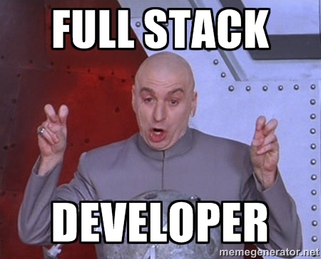
Full-Stack Development?

Slide 42

The “Magic” of YouTube

Slide 43
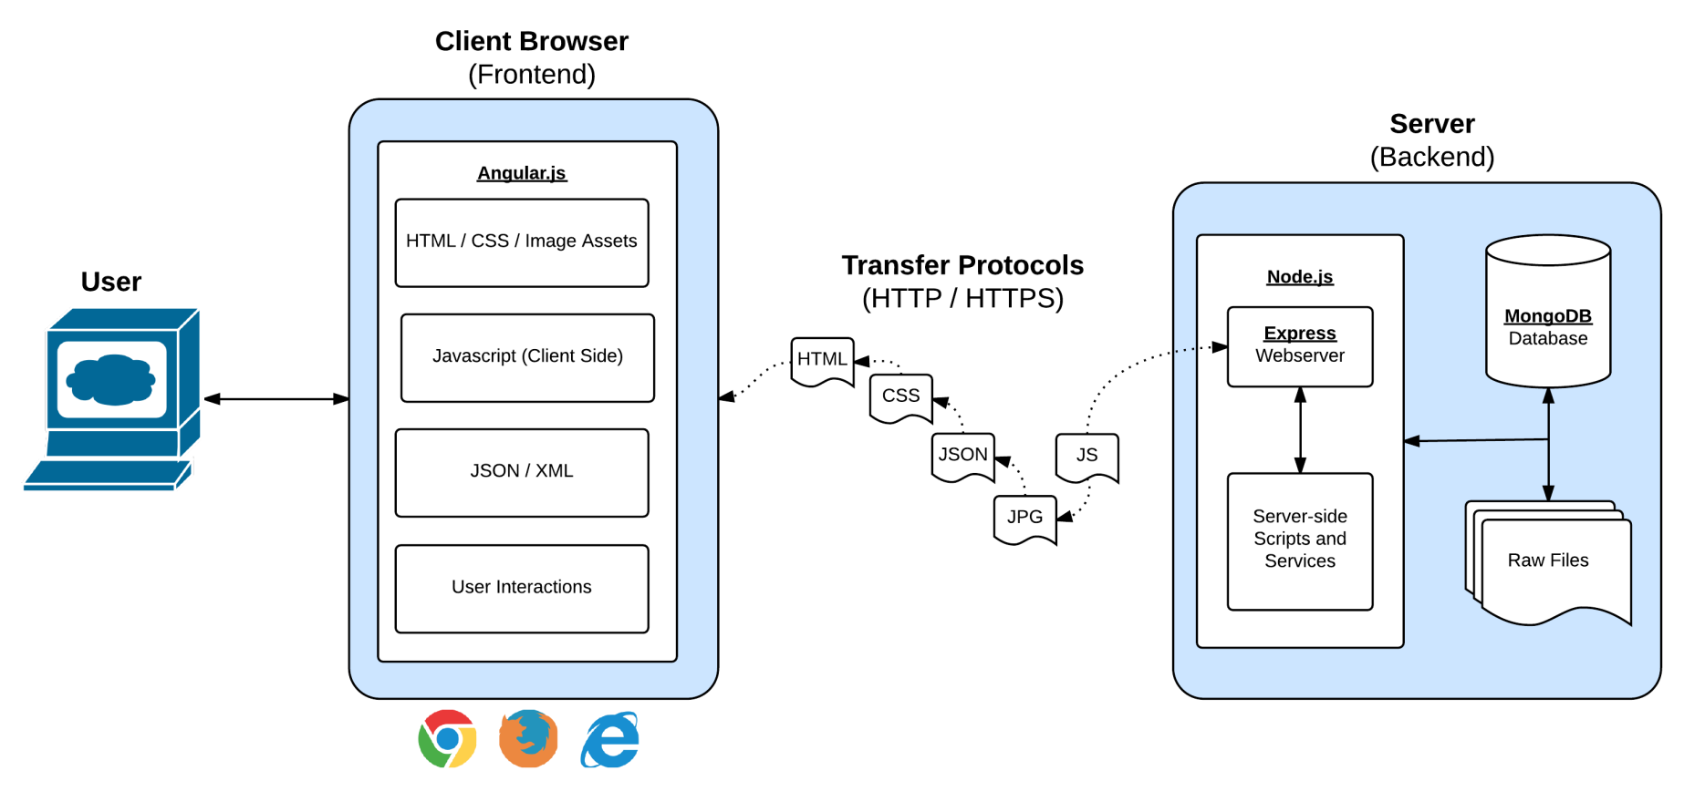
Full-Stack Development
In modern web apps, there’s a constant back-and-forth communication between two key components: the visuals displayed on the user’s browser (frontend), and the data and logic stored on the server (backend).

Slide 44
Full-Stack Development
Full-Stack Development is the concept of building every aspect of the web application – from the visuals and interactions, to the data transfer and processing.

Slide 45
What You’ll be Learning…
The Browser
Dev Tools
Server Side
HTML
CSS
JavaScript
jQuery
Bootstrap
SEO
Heroku
Git
GitHub
Templating Engines
Sessions
Writing tests
Node.js
Express.js
Creating APIs
MVC
User Authentication
ORM (Sequelize)
Meteor.js
Databases
MySQL
MongoDB
API Interaction
APIs (Consuming)
JSON
AJAX
Real Time Cloud Database via Firebase
Algorithms
Design Patterns
CS Fundamentals
Cutting Edge Development
React.js

Slide 46
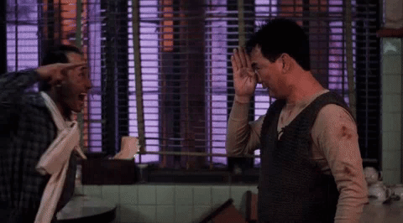
Google Foo – The Most Important Skill of All
What is Google Fu?

Slide 47
Let’s Get Crackin!

Slide 48

Intro to Console / Terminal

Slide 49
INSTRUCTOR DEMO
Instructor: Demo
(1-ConsoleCommands)

Slide 50
> YOUR TURN!
Activity: Get Situated | Suggested Time: 1 min
Assignment:
Make a folder on your desktop named code.
Put all of you code that you do inside of that folder.
Best Practices:
Always use lowercase for folder and file names.
Never put in spaces in your folder and file names.
Use dashes to separate.

Slide 51
> YOUR TURN!
Activity: Console Commands | Suggested Time: 12 min
Assignment:
From the Terminal / Console and using only the command line, create:
A new folder with the name of first_day_stuff.
A new HTML file with the name of first_day.html.
Open the current folder containing the new HTML file.
Bonus:
Create multiple directories/folders with the names one_folder and second_folder in one command.
Create multiple files with the names one.html and two.html in one command in the first_day_stuff directory.

Slide 52
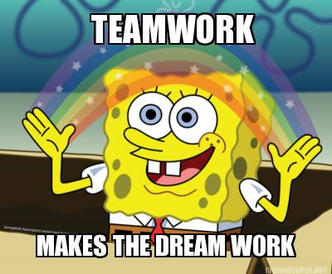
Intro to Console
Discuss with Neighbors

Slide 53
Hello, HTML

Slide 54


<title> Intro to HTML </title>
HTML is one of the three base languages behind every single website.
It defines all of the basic content and a bit of formatting.

Slide 55
INSTRUCTOR DEMO
Instructor: Demo
(Basic HTML Doc)

Slide 56
> YOUR TURN
Assignment:
In a new HTML file, create the basic structure of an HTML document and include the following in it:
DOCTYPE declaration.
Head tag with a title tag.
H1 tag with a title of your choice.
Embed an image.
Create the following three links on your page:
One link that is target="_blank" so that it opens a new tab when clicked on.
Make the second link bold.
Make the third link a placeholder so it goes nowhere.
Bonus:
Create an ordered list of steps to make a sandwich.
Create an unordered list of 5 bands/musicians you like.
Create a table with 2 columns (animal class, animal name) and have 4 rows of animals
Use an alternate way of separating links without line breaks.
Embed a YouTube video of your favorite band/musician.

Slide 57

YouTube Video Walkthrough!
https://www.youtube.com/watch?v=ieb6Svbc10E&index=1&list=PLgJ8UgkiorCnMLsUevoQRxH8t9bt7ne14

Slide 58
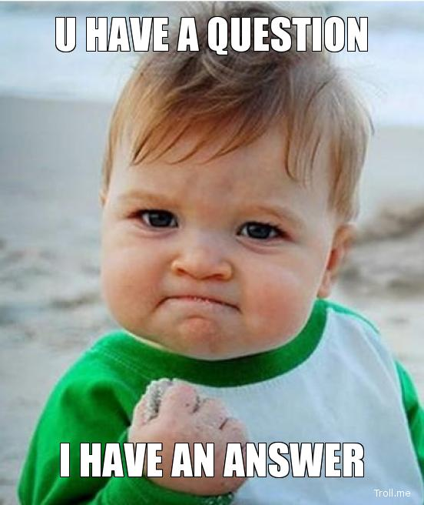
<title> Intro to HTML </title>
How’d it go?

Slide 59
Homework!

Slide 60
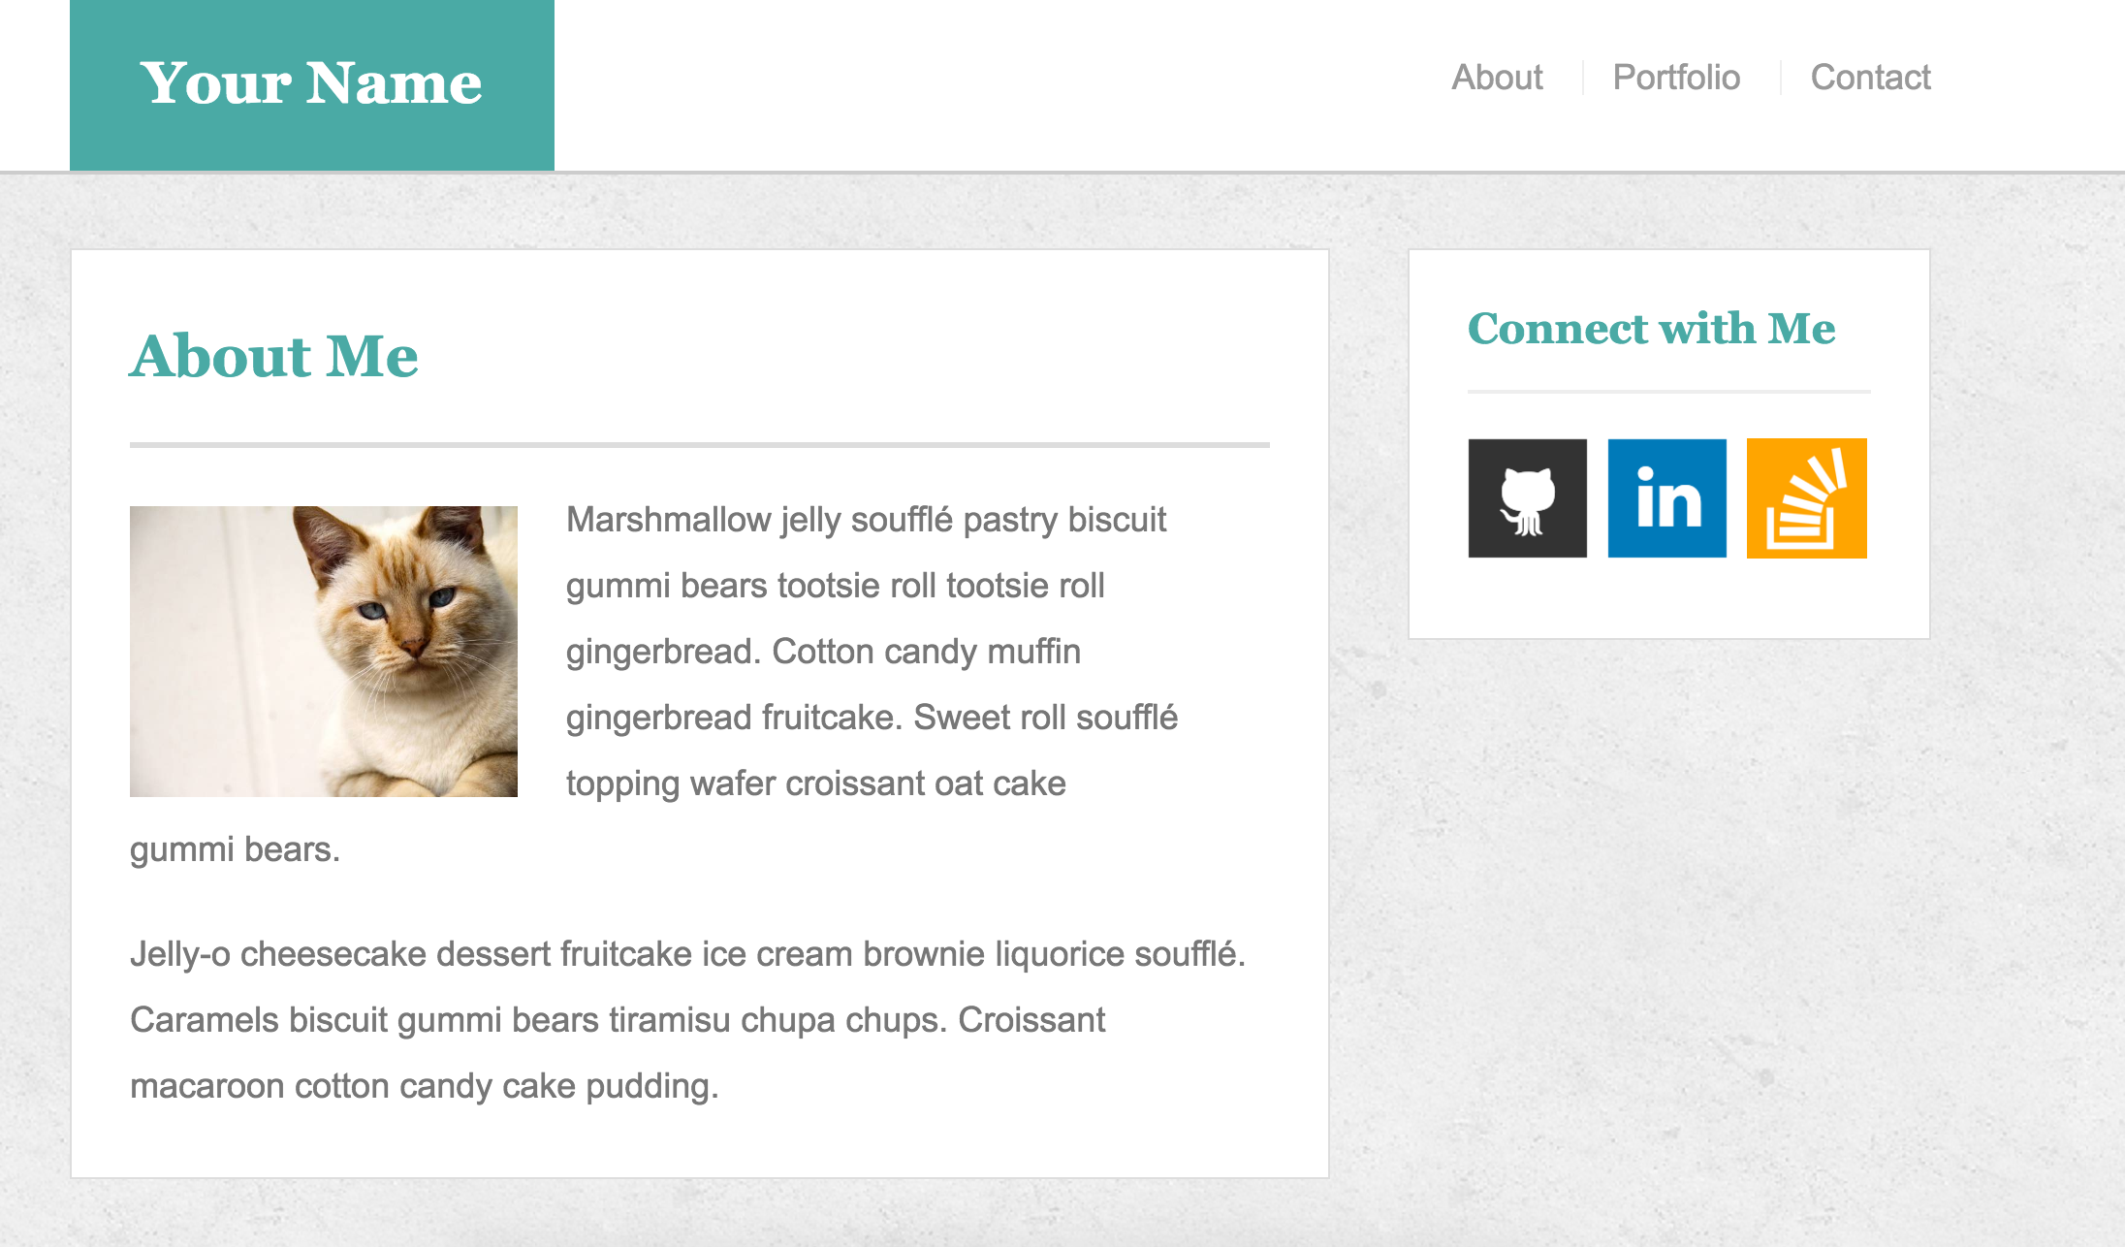
Homework Due: Next Thursday (8/11)

Slide 61
Homework “Due”: Next Class
By Next Class:
Read Ahmed’s Keys To Success if you haven’t already. Really read it.
Read Advice from the Previous Class.
Figure out where the GitHub Repo is for our class is ☺
Re-do the Terminal example from class today.
Re-do the HTML example from class today.
Watch the Walkthrough Video if you felt a bit lost.

